Slide 1
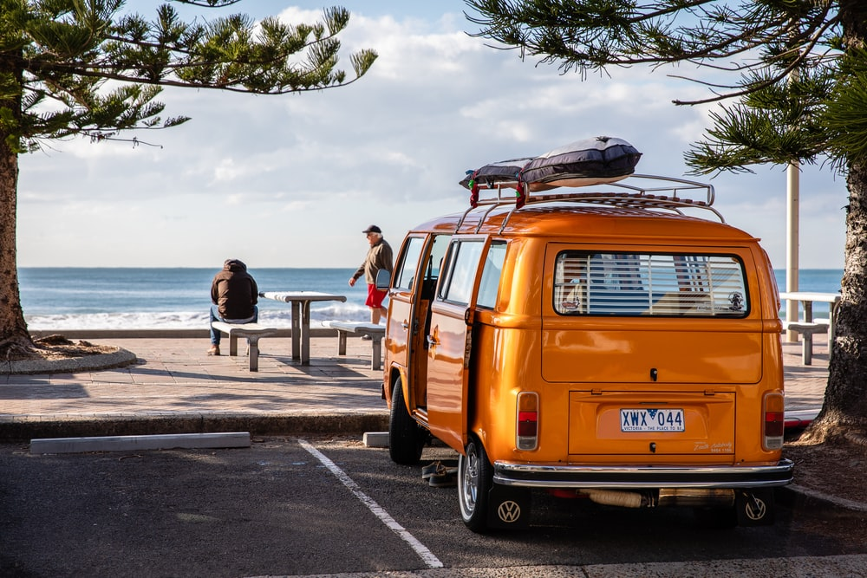
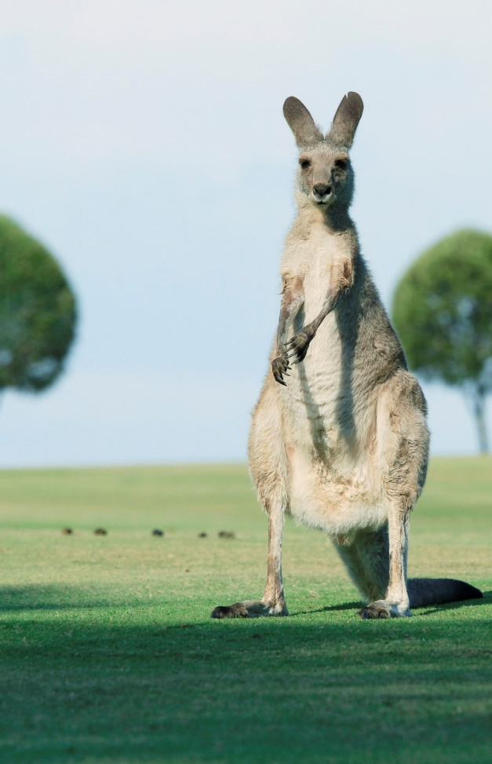
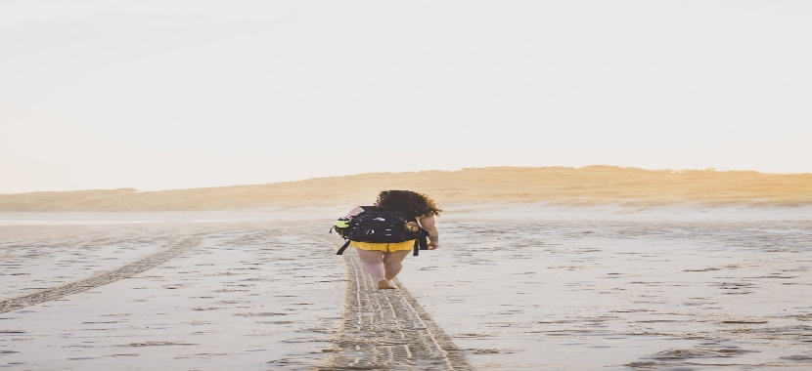
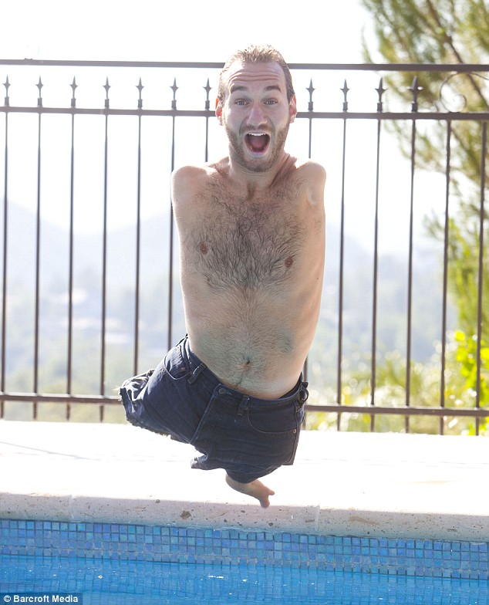
Dell Conversation Class Australia
Christopher bAUMAN

Slide 2
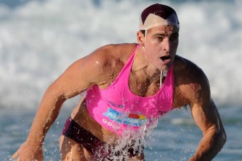
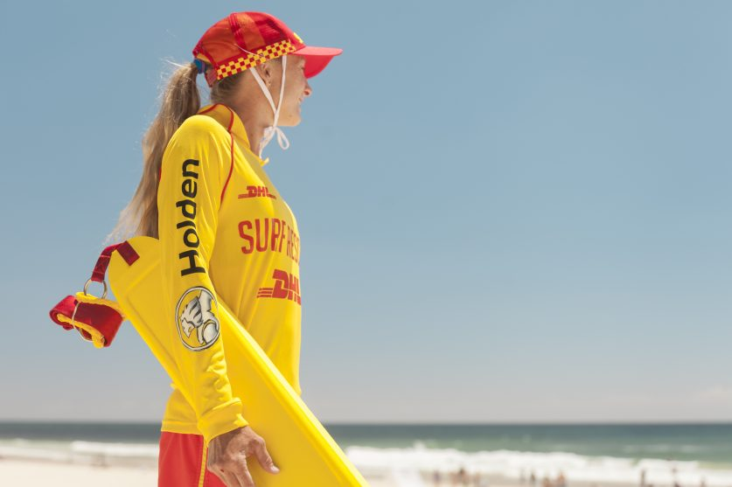
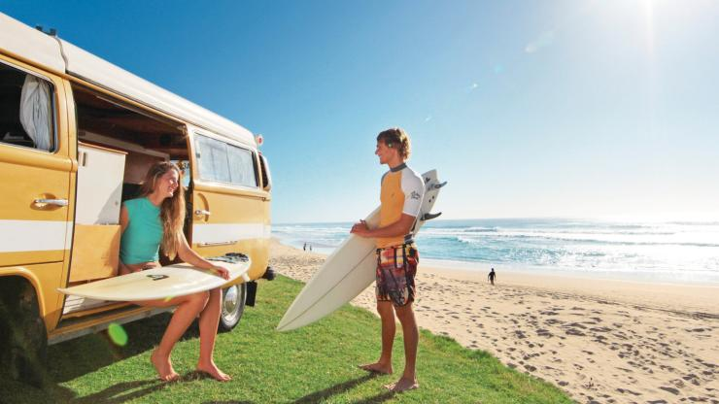
Education Infographic
Weather
Time Zones
Getting a job
Working holiday
Visa
Health
Food
Blogger
Transport
Safety
Thongs
Breakie
Volunteer
Theme parks
Australia Zoo
Learn a skill
Teachers
Education
Skills
Chris Bauman

